Slide 1

DATA VISUALIZATION M.DRUMARE

Slide 2
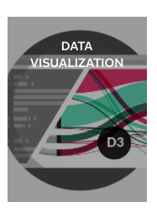
ON FLIPBOARD
http://flip.it/Xb6yVi

Slide 3
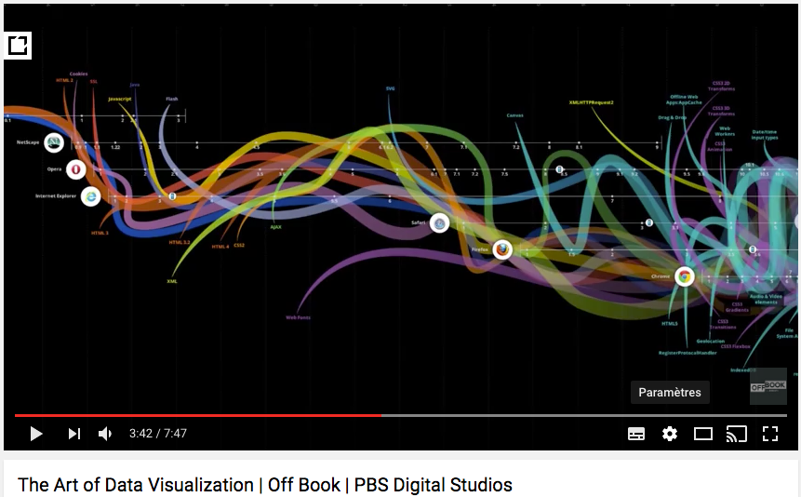
THE ART OF DATA VISUALIZATION

Slide 4
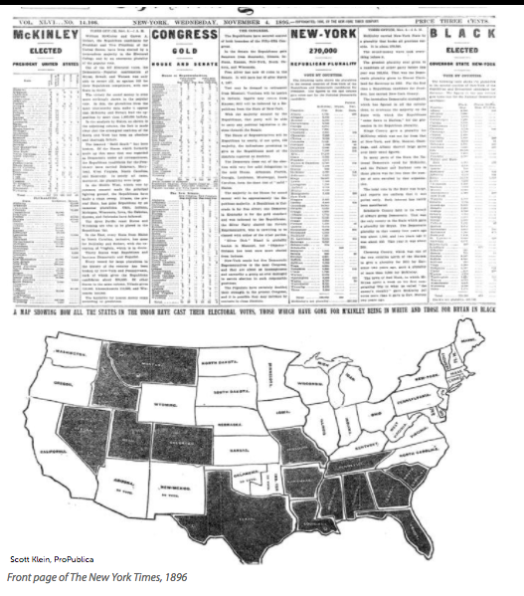
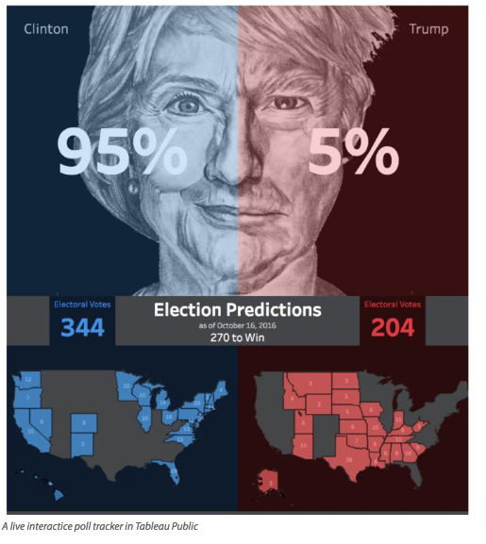
THE U.S ELECTION THROUGHOUT HISTORY
1886
2016

Slide 5
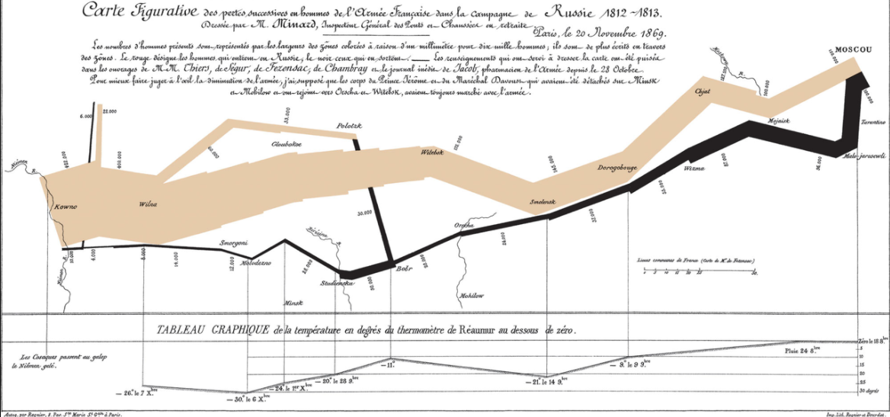

AN OLD STORY
1869, Minard’s Map
Minard’s Map in 2013
http://www.masswerk.at/minard/

Slide 6
WHAT ?

Slide 7
NEW DIGITAL FRONTIER
« The ability to take data, -to be able to understand it, -to process it, to extract value from it, -to visualize it, to communicate it, that's going to be a hugely important skill in the next decades. »
Hal Varian, Google's chief economist

Slide 8

X FACTORS
SOCIAL MEDIA
MOBILE
INTERNET OF THINGS
CLOUD

Slide 9

THE BIGGEST CHALLENGE
« The biggest challenge of the Petabyte Age won't be storing all that data, it'll be figuring out how to make sense of it »
Martin Wattenberg, IBM's Watson Research Center
Petabytes Age
https://lc.cx/o9gR

Slide 10
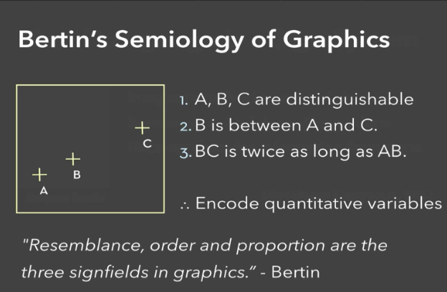
WHAT IS DATA VISUALISATION?
« The visual analysis of and communication of data »
« The representation and presentation of data that exploits our visual perception abilities in order to amplify cognition » Andy Kirk
1967

Slide 11
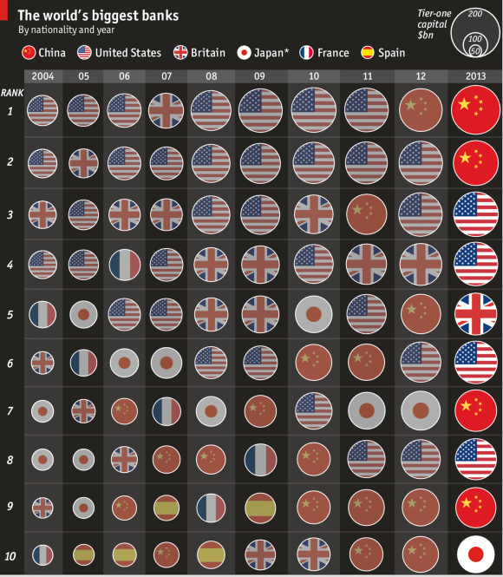
WHAT IS DATAVISUALISATION?
"It's just a common mistake to think that charts are a just a fancy way of showing numbers.....They are tools for understanding »
Robert Kosara, Eager Eyes.org

Slide 12
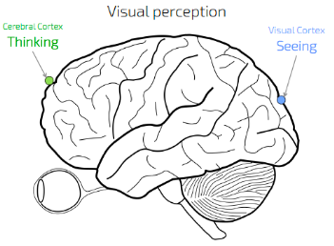
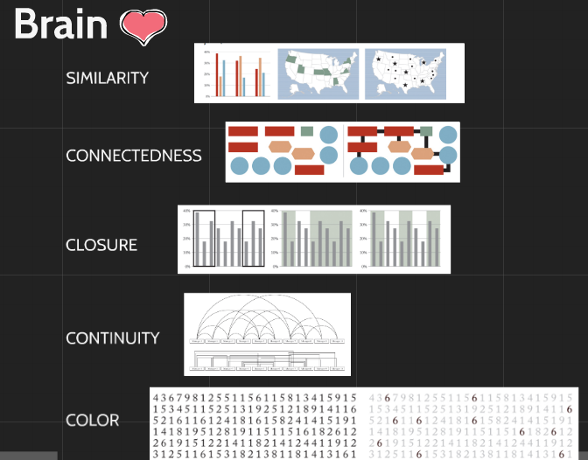
HOW DATA VISUALIZATION IS POSSIBLE ?
Seeing>Thinking

Slide 13
WHY CREATE DATA VISUALIZATION?
Answer question and discover them
Make decisions
See data in context
Expand memory
Support graphical calculation
Find patterns
Present arguments or tell a story
Inspire

Slide 14
HOW ?

Slide 15
DATA VISUALIZATION METHODOLOGY
1/Establish the visualization’s purpose.
2/Acquire and prepare your data.
3/Determine the editorial focus.
4/Conceive your design.
5/Construct and modify your design solution.

Slide 16
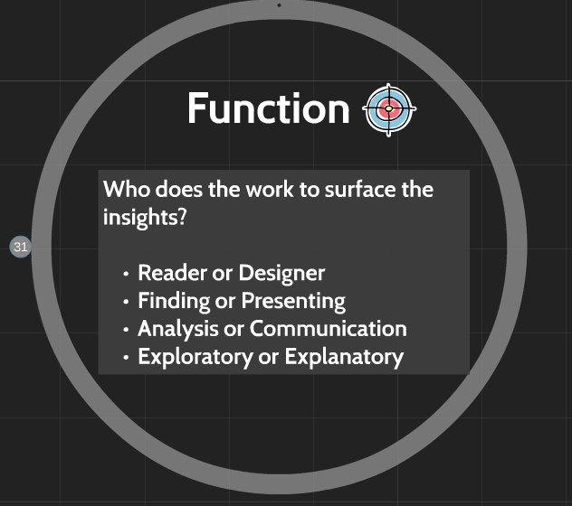
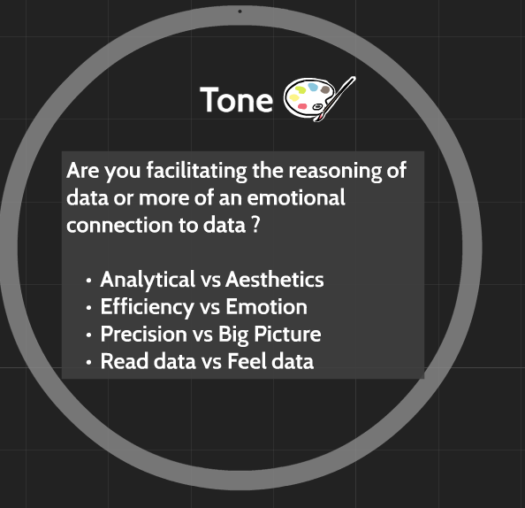
THE VISUALIZATION’S PURPOSE

Slide 17
ACQUIRE YOUR DATA
Companies
Governements and Ngos
'Local' Data ( smart cities)
Services and Marketplaces
Social Networks
Portals and Platform
Newspaper and Media
Open Data
Universities
Mapping Transport and Travel
Earth, Space and Beyond
Weather and climate

Slide 18
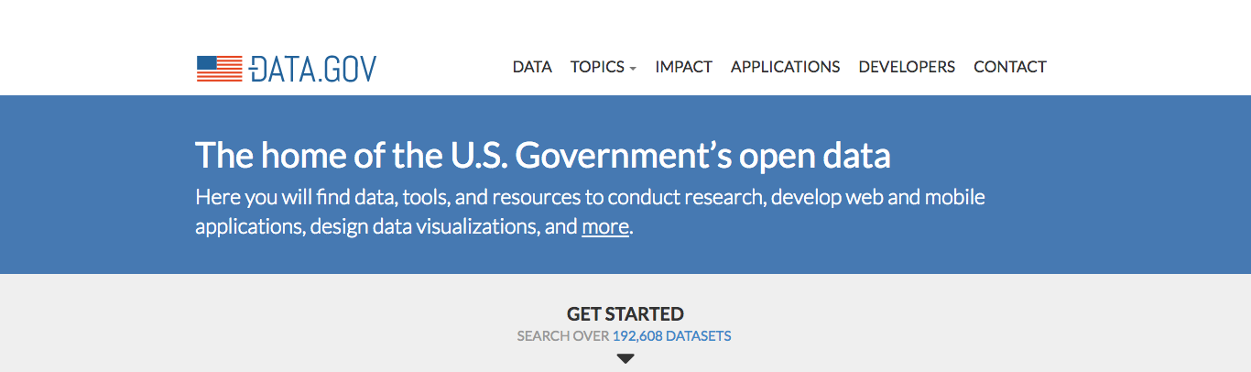

OPEN DATA MADE IN USA / IN FRANCE
https://www.data.gov/
http://www.data.gouv.fr/fr/

Slide 19
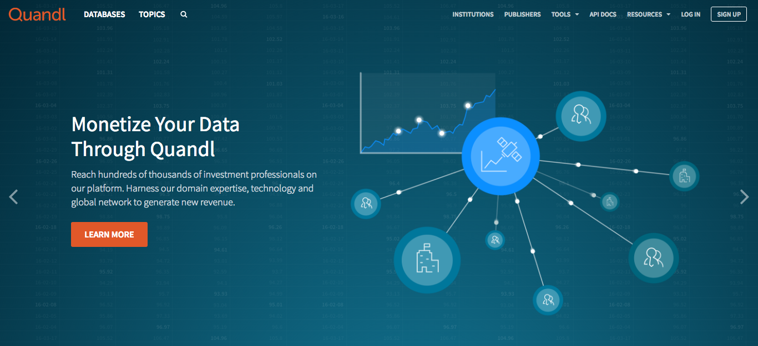
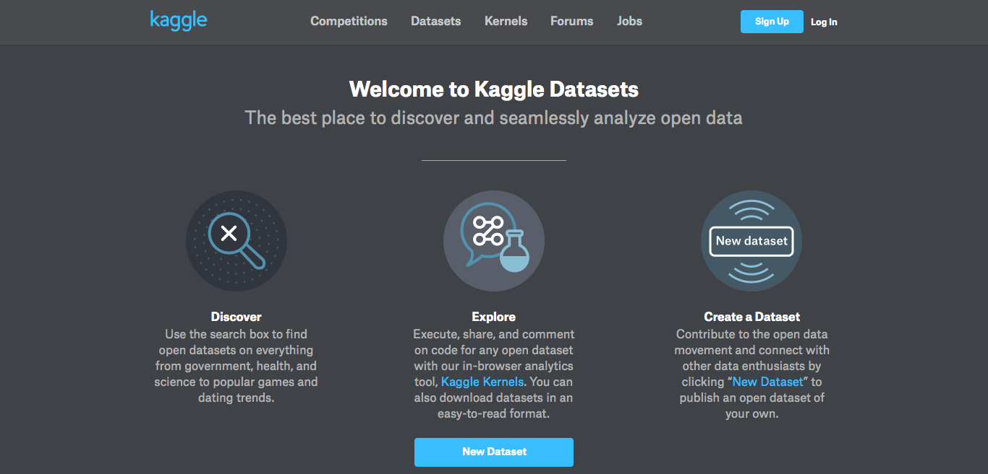
DATA REPOSITORIES ON THE WEB
https://www.kaggle.com/datasets
http://www.assetmacro.com
http://usgovxml.com
http://aws.amazon.com/datasets
http://databib.org
http://datacite.org
http://figshare.com
http://linkeddata.org
http://reddit.com/r/datasets
http://quandl.com
http://thewebminer.com
Open Data Inception - A Comprehensive List of 2500+ Open Data Portals in the World

Slide 20
PREPARE YOUR DATA
60-80% of the work
Examination : meaning (nominal, ordinal, quantitative)
Examination : physically (data shape)
Transformation : clean (missing, incorrect, duplicate)
Transformation : consolidate(create new value, compare with other assets)
Tableau Project Maestro
https://lc.cx/o9gz

Slide 21
DETERMINE THE EDITORIAL FOCUS
Think about your audience (influencers ? consumers? managers?)
What do you know about the subject (experience/ knowledge)
What you have found (research)?
First Exploration and Visual Analysis (Data cleaning and manipulation)

Slide 22
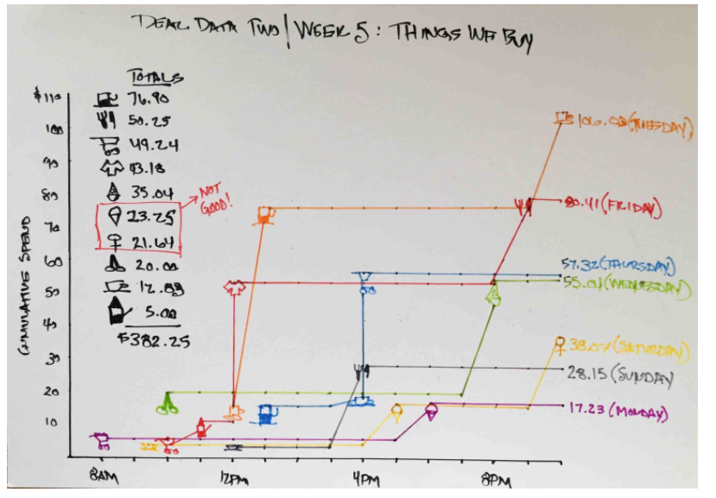
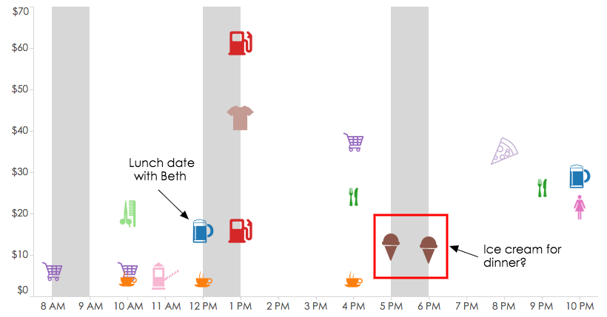
CONCEIVE YOUR DESIGN
Draft
The Dashboard

Slide 23
CONSTRUCT A DESIGN SOLUTION AS A STORY
Actors : data
Scenari and acting : charts
Directory: colors, interactivity, annotation, structure.
Technology: tools, frameworks
Staff: data analyst, business analyts, data-driven managers.
3 Story Points Dashboards and stories - Tableau Advanced, 2015.

Slide 24
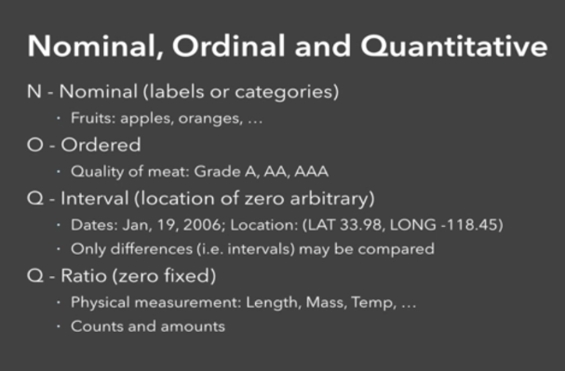
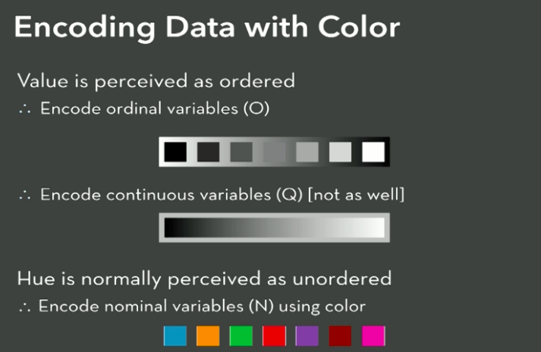
ACTORS : DATA

Slide 25
SCENARI AND ACTING : CHARTS
Scenari | Acting
Comparing quantitative and categorical values | Bar Chart, Dot Plot, Radar Chart , Pyramids, Lolipop.
Charting hierarchical & part-to-whole relationships | 100% Stacked Bar Chart, Tree Map, Pie Chart, Waterfall.
Plotting trends and changes over time | Line Chart, Multi-Line Chart, Area Chart, Slopegraph, Slope Chart, KPI Chart.
Graphing connections and relationship | Scatter Plot, Bubble Plot, Heatmap, Box Plot, Radial/Chord Diagram, Network Diagram
Mapping spatial Data | Connection Map, Bubble Plot Map, Choropleth Map

Slide 26
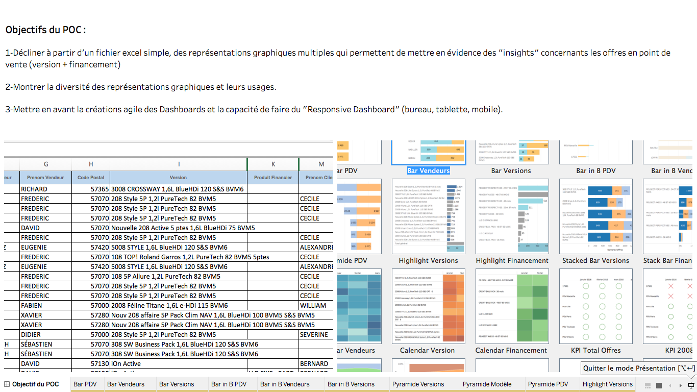
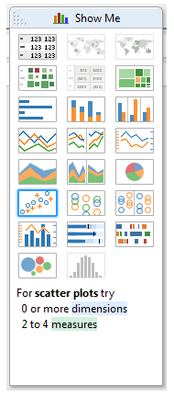
DEMO: POC VISUALIZATION TABLEAU

Slide 27
SPECIAL EFFECTS
Multiple point of entry : http://urlz.fr/4n4S
Multiple layer of detail : http://urlz.fr/4n4U
Participation /personalisation : http://urlz.fr/4n4V
Gamification : http://urlz.fr/4n4W
Story over time : http://urlz.fr/4n4X
Video graphics : http://urlz.fr/4n4Z
Touchscreen interface : http://urlz.fr/4n51
Responsive design interface: http://urlz.fr/4n8Z , http://urlz.fr/4n90

Slide 28
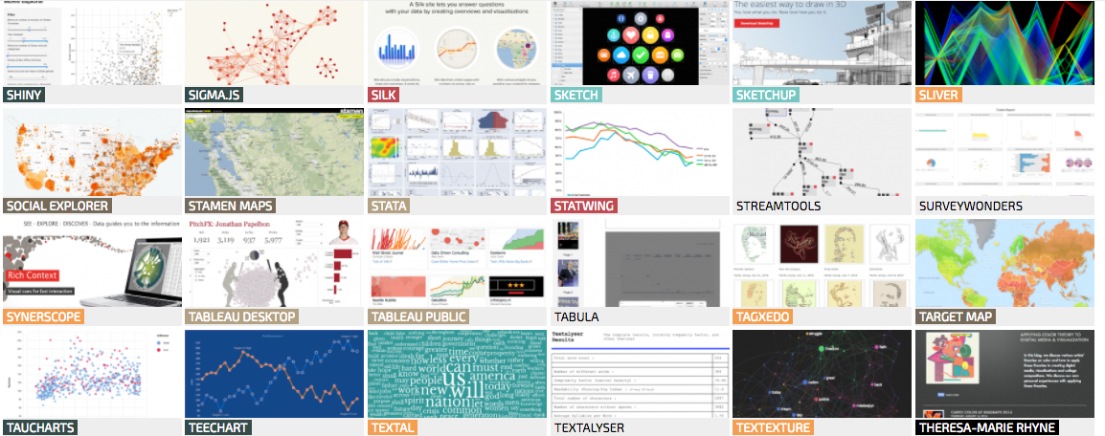
DIRECTORY : TOOLS & FRAMEWORK
http://www.visualisingdata.com/resources/

Slide 29
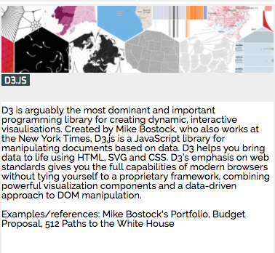
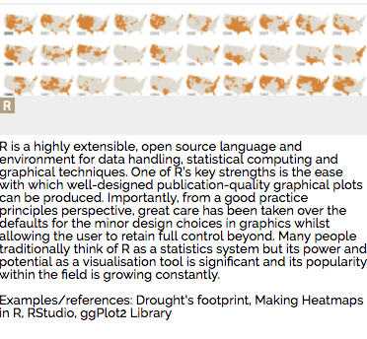
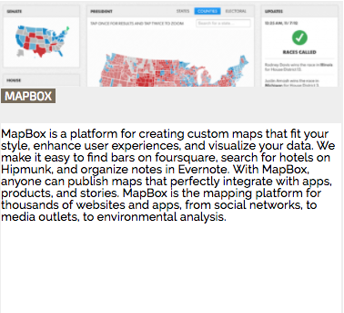
DIRECTORY : TOOLS & FRAMEWORK
https://d3js.org/
http://docs.ggplot2.org/
https://www.mapbox.com/gallery/

Slide 30
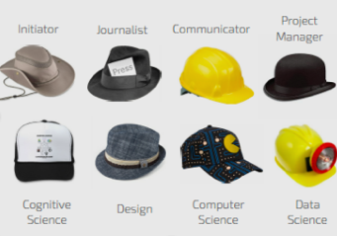
STAFF:
Visualization designers are melding the skills of computer science, statistics, artistic design and storytelling.

Slide 31
NOT ONLY ONE STORY
Brief
Context
Budget
Time
Pressure
Infrastructure
People
goo.gl/cbdHCb

Slide 32
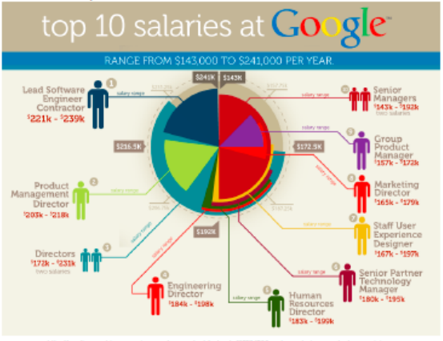
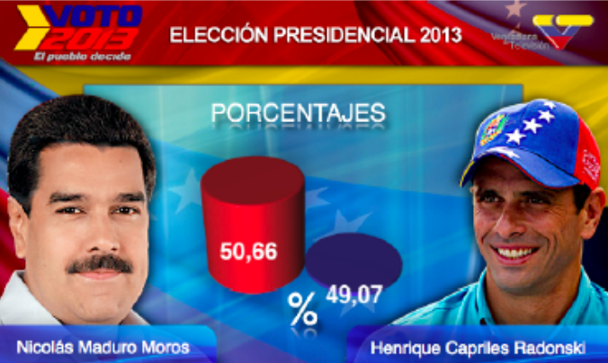
VERY BAD TRIP

Slide 33
IMPACTS ?

Slide 34
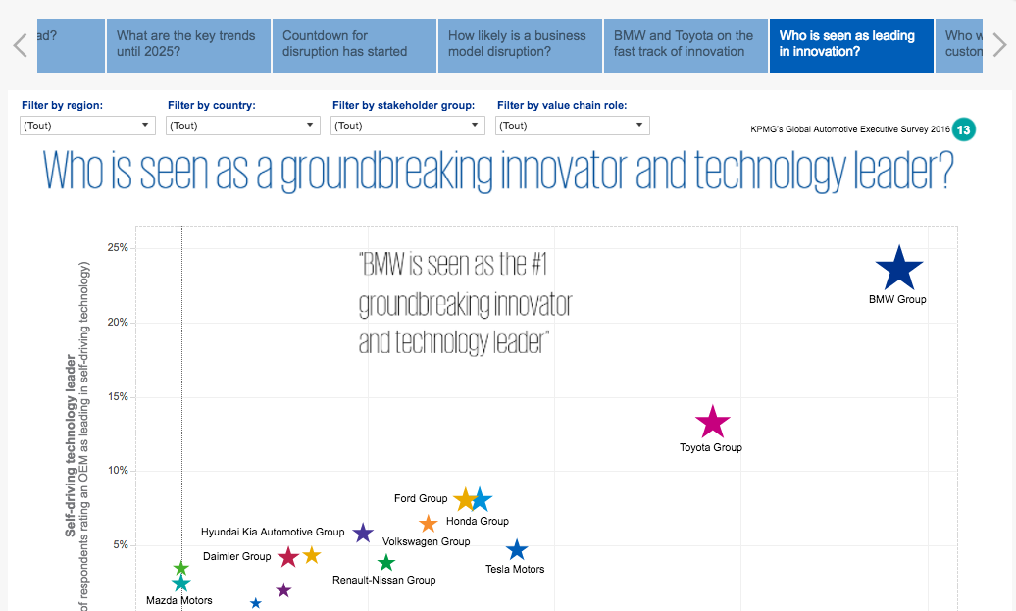
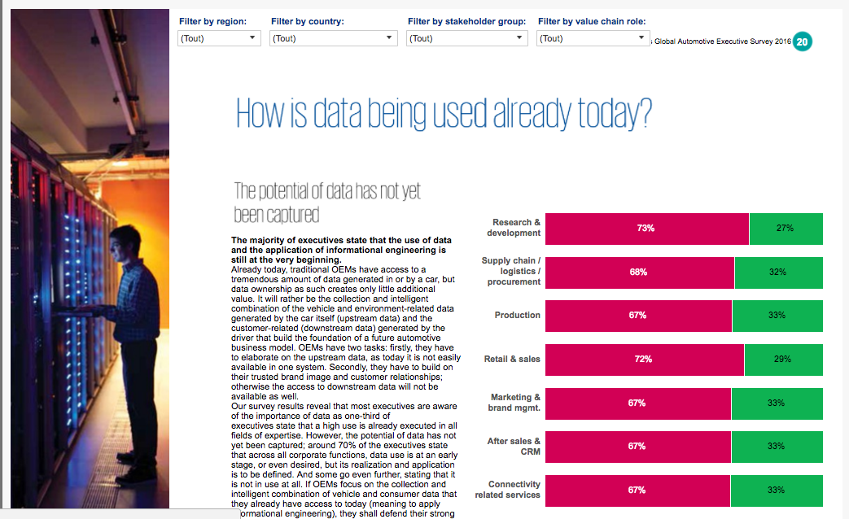
ON CONSULTANCY
http://urlz.fr/4nnk

Slide 35
ON DECISION MAKING
« Not long ago, the ability to create smart data visualizations, or dataviz, was a nice-to-have skill. For the most part, it benefited design- and data-minded managers who made a deliberate decision to invest in acquiring it.
That’s changed. Now visual communication is a must-have skill for all managers, because more and more often, it’s the only way to make sense of the work they do. »
Scott Berinato, HBR, June 2016

Slide 36
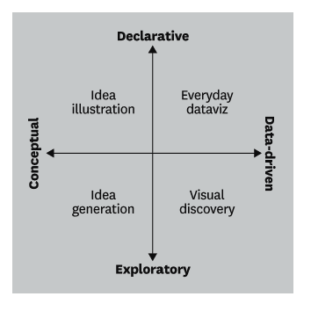
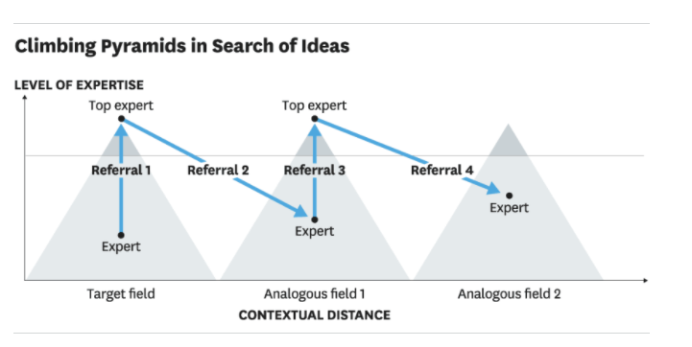
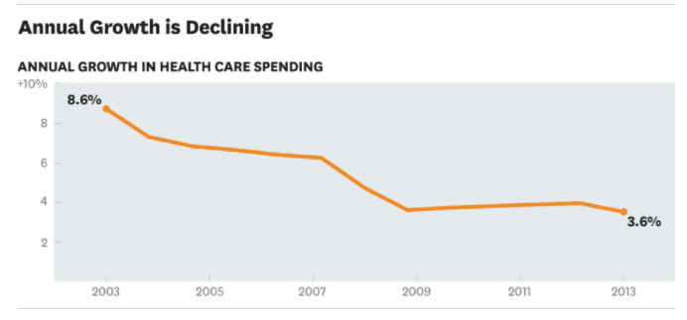
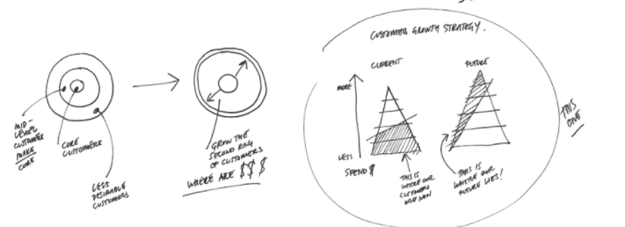
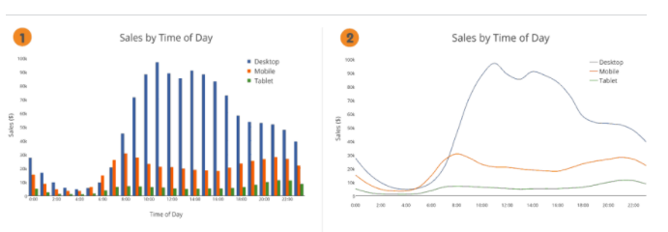
ON MANAGEMENT
Visual communication is a must have skill for all managers
Is the information conceptual or data-driven? (ideas vs statistics)
Am I declaring or exploring something? (affirm vs confirm)
Two kinds of exploratory vizualizations : test an hypothesis or don’t know what your are looking for.

Slide 37
ON SECTORS ON ACTIVITIES
Agriculture and Climate
Assurance
Bank
Defense and Security
E-commerce, Social networks, IoT
Education
Entertainement
Health & Biotech
Industry 4.0
Journalism
Mobility & Smart City
Transport & Tourism
Sport…
Research
Marketing
Commerce
Communication
Human Ressources
Supply Chain
Finance……

Slide 38
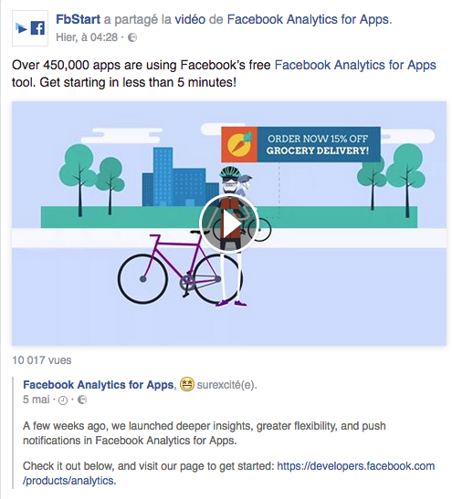
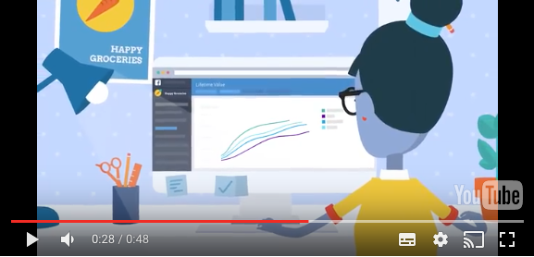
SOCIAL NETWORKS: FACEBOOK ANALYTICS FOR APPS
Make Smarter Decisions with Facebook Analytics for Apps

Slide 39
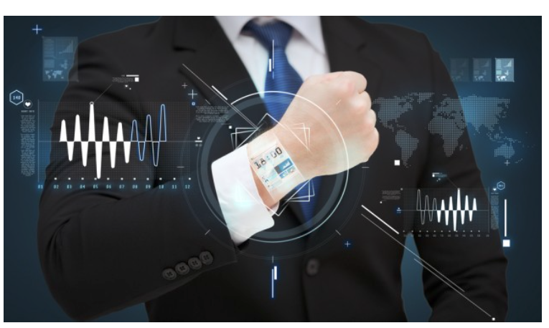
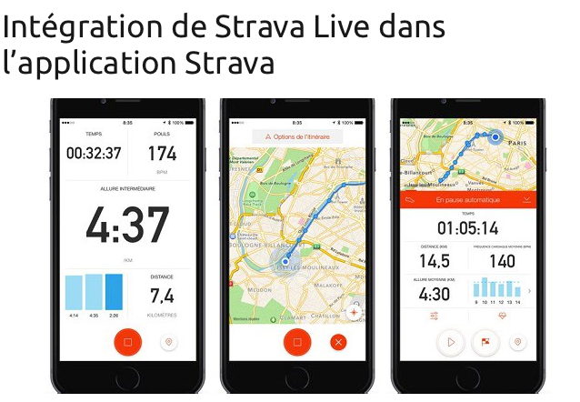
IoT & WEARABLES : STRAVA QUANTIFIED SELF

Slide 40
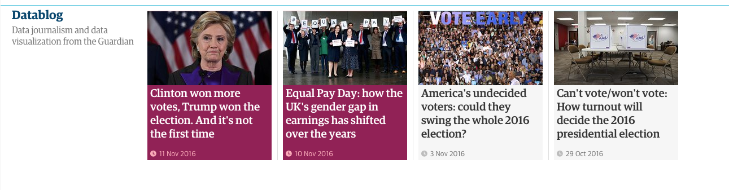
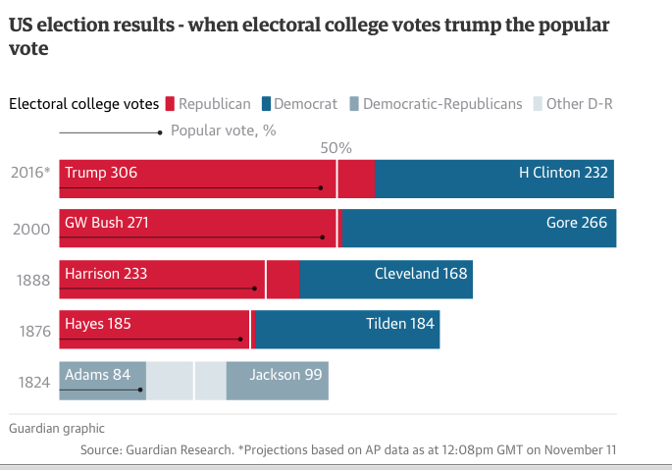
DATA JOURNALISM : THE GUARDIAN

Slide 41
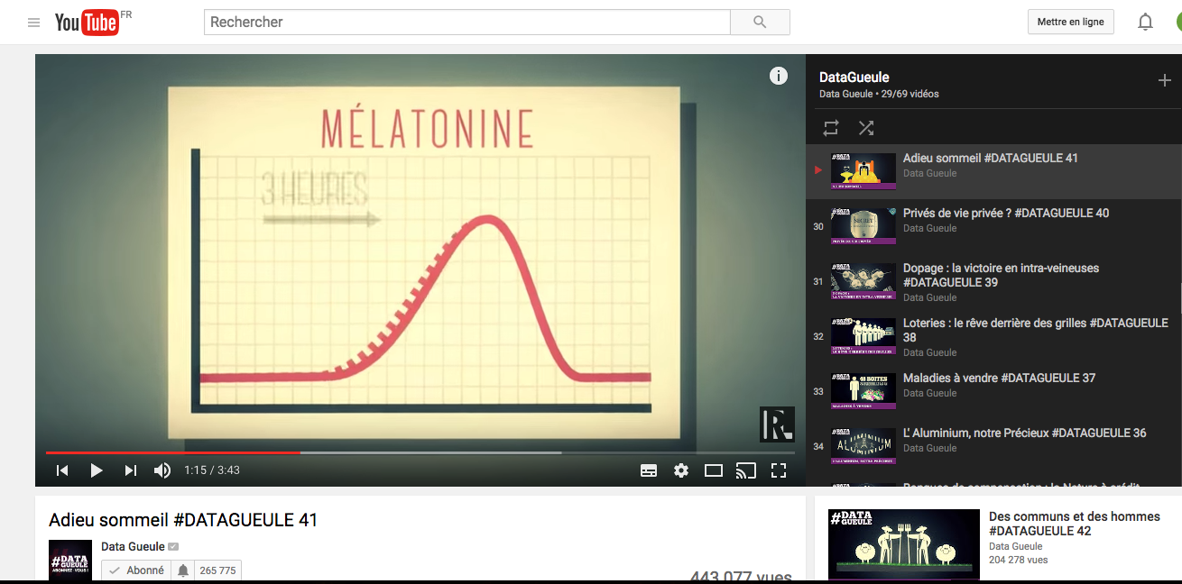

DATA JOURNALISM : #DATAGUEULE

Slide 42
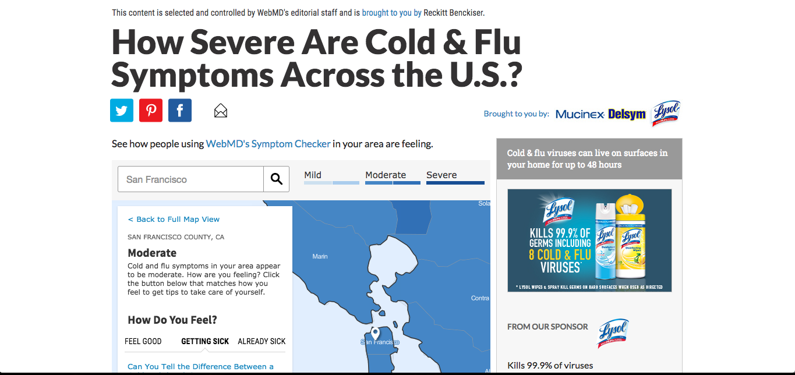
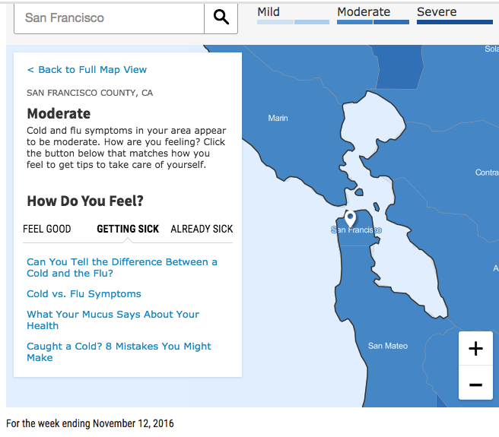
HEALTH : FIGHT AGAINST THE FLU

Slide 43
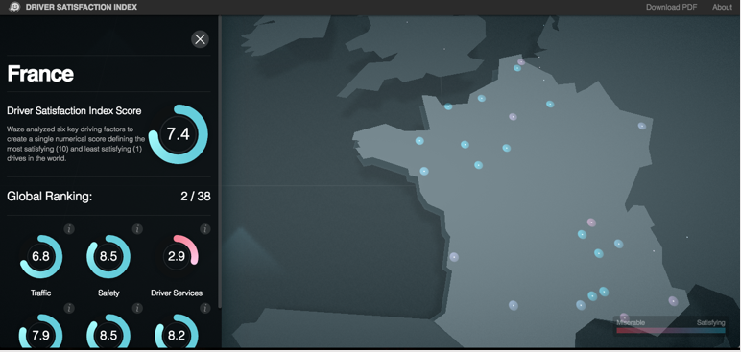
MOBILITY AND SMART CITY: WAZE DRIVER INDEX

Slide 44
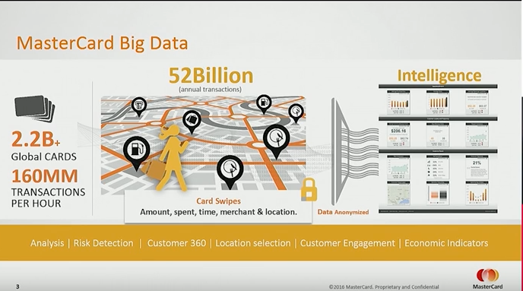
BANK : MASTERCARD

Slide 45
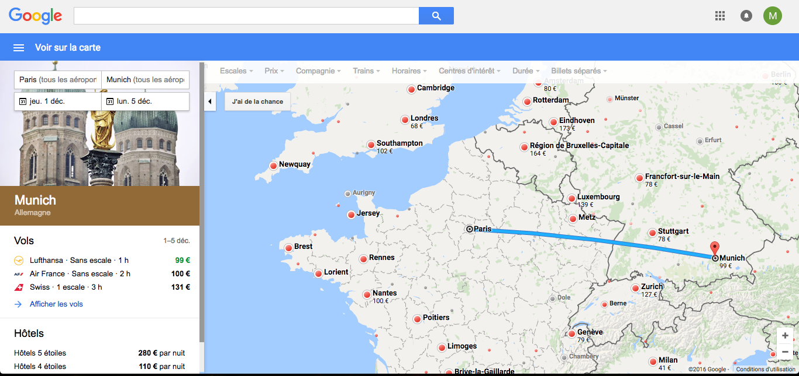
TOURISM: GOOGLE FLIGHT & HOTELS

Slide 46
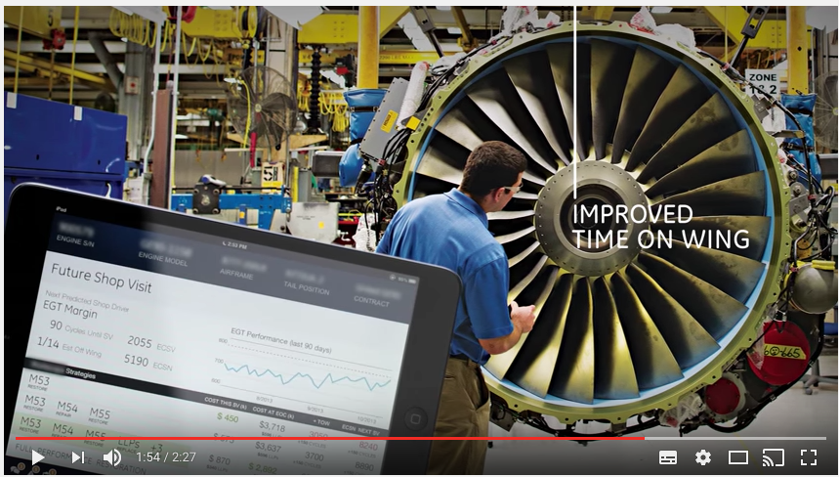
INDUSTRY : GE PREDIX

Slide 47
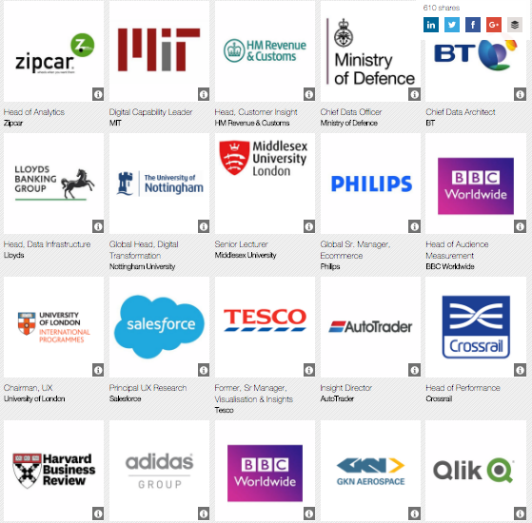
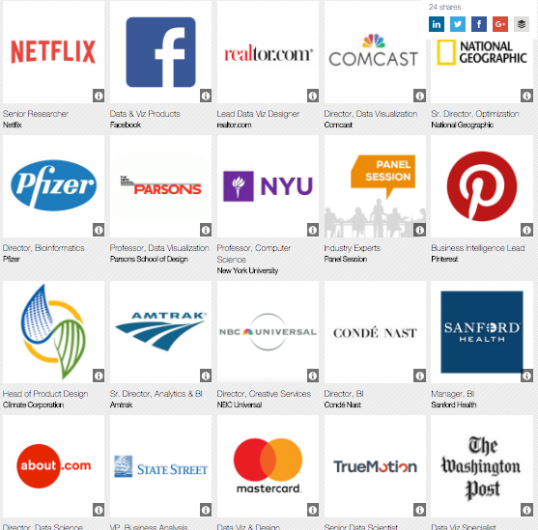
SPEAKERS AT THE DATA VISUALIZATION SUMMIT
London 2016
Boston 2017

Slide 48
